Slide 1
Traffic sign recognition
R. HARINI 18BCE1010
MASOOMA SULEMAN 18BCE1140
GARIMA DAVE 18BCE1232

Slide 2
INTRODUCTION
There are different types of traffic signs like speed limits, no entry, traffic signals, turn left or right, children crossing, no passing of heavy vehicles, etc.
Traffic signs recognition is the process of identifying which class a traffic sign belongs to.
This application can be used in self driving cars also.
We will build a deep neural network model that will classify traffic signs present in the image into different categories.
We will also try to estimate the minimum distance for the vehicle to recognise the sign before performing the respective action.

Slide 3
DATASET DESCRIPTION
Contains more than 50,000 images of different traffic signs, classified into 43 different classes
Dataset contains the following columns :
Path – The path to direct to image.
ClassId – Class ID of the image.
ShapeId – Shape of sign (0-red, 1-blue, 2-yellow, 3-white)
ColorId – Color of sign (0-triangle, 1-circle, 2-diamond, 3-hexagon, 4-inverse triangle)
SignId – SignID issued by the Traffic Rule Department

Slide 4
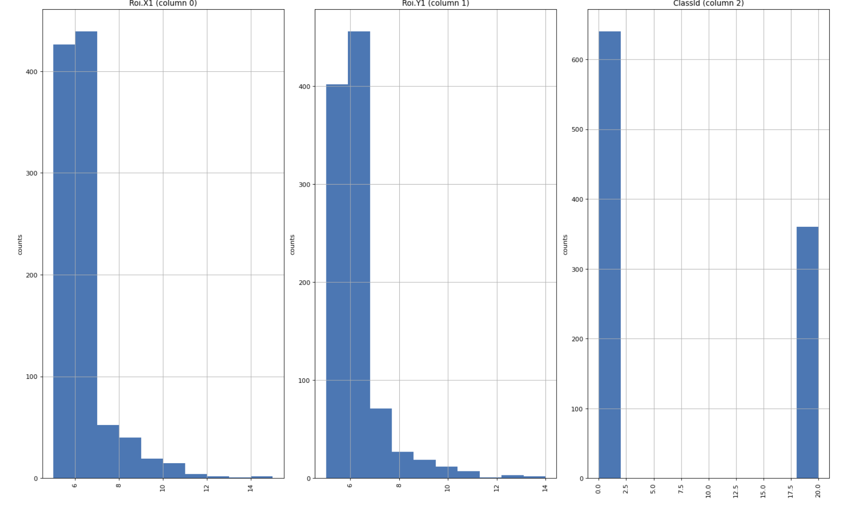
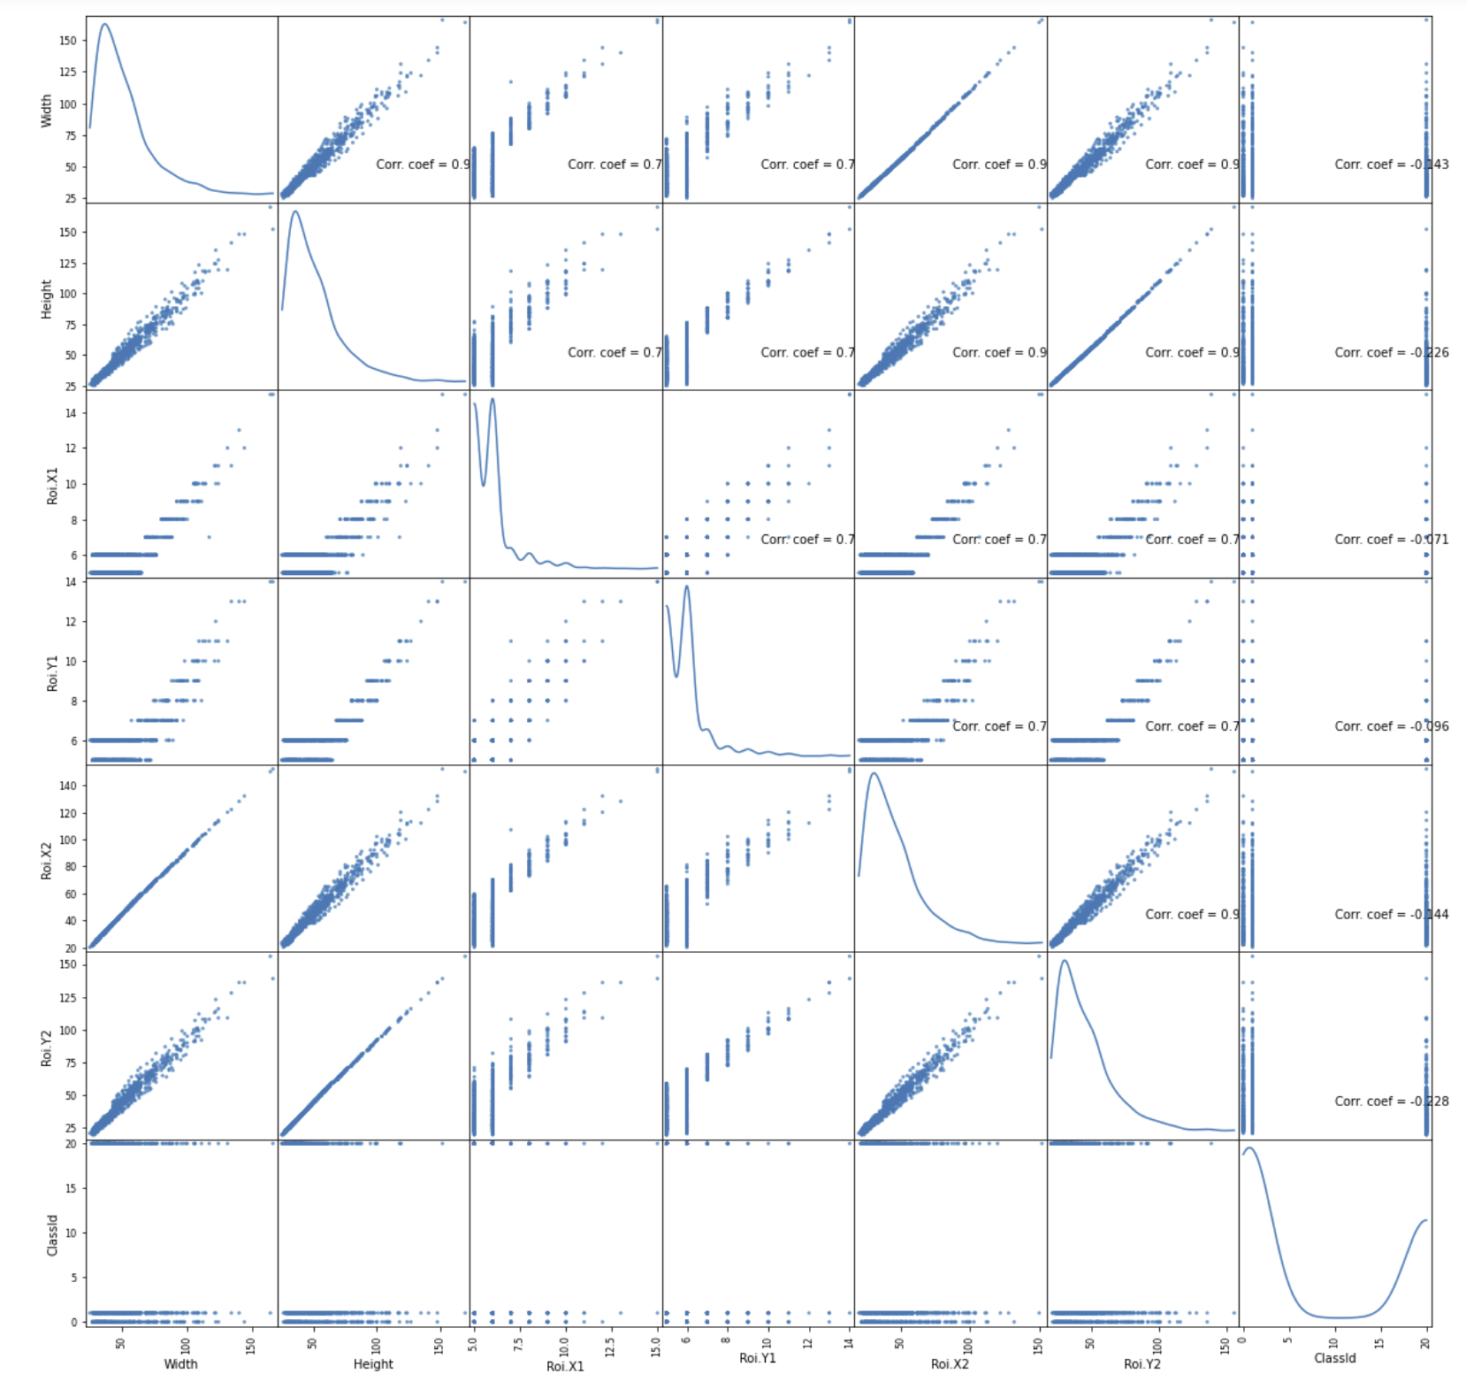
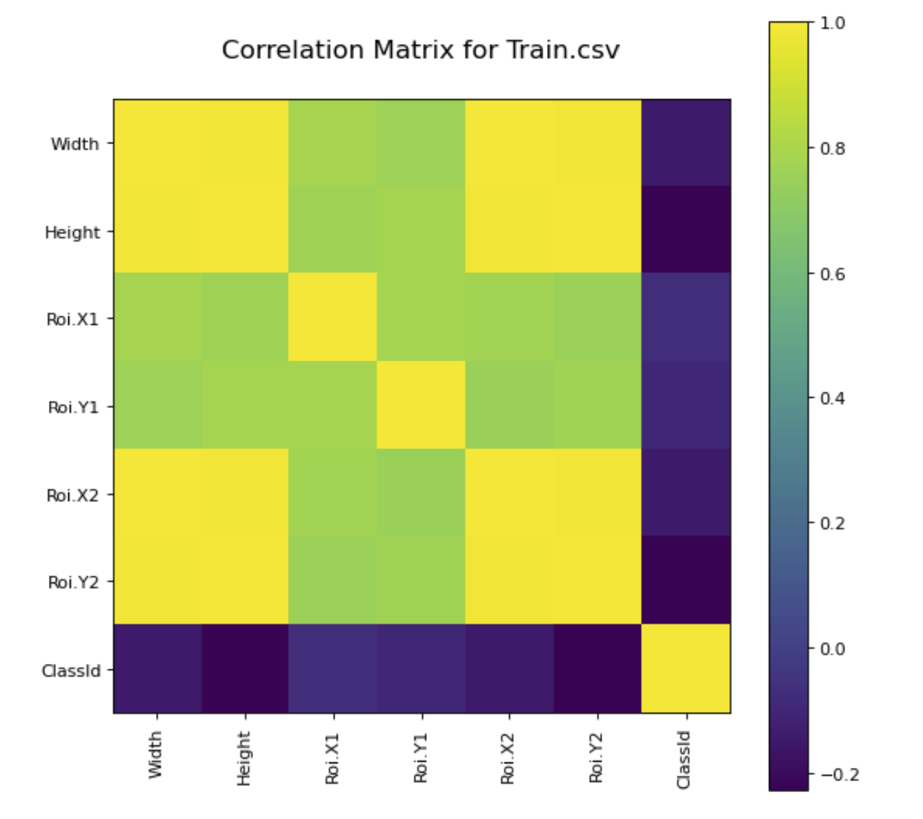
GRAPHS

Slide 5
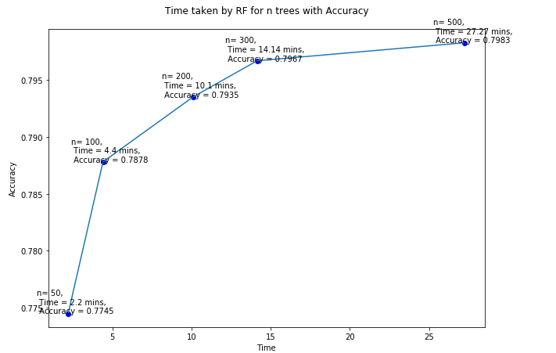
GRAPHS

Slide 6
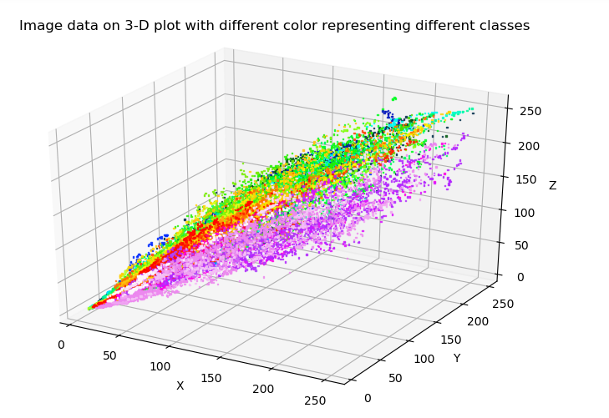
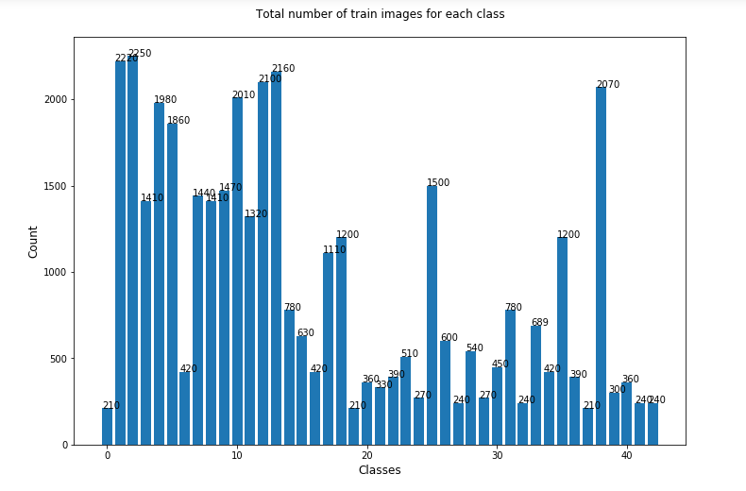
GRAPHS

Slide 7
COMPARISON OF MODELS
MODEL NAME | ACCURACY
DNN+ GridSearch Algorithm | 94.66%
Random Forest | 79.67%
Supper Vector Machine | 82.5%
Modified LeNet | 94.13%
LeNet without Dropout | 94.91%
Traditional LeNet | 97.13%

Slide 8
PREDICTION TIME
Stopping Time for a vehicle: 6.87s
Model + Processor | Prediction Time (seconds) | Total Time Taken (seconds)
ConvNet (CPU) | 0.37s | 7.24s
ConvNet (GPU) | 0.14s | 7.01s
Random Forest (CPU) | 0.39s | 7.26s
Random Forest (GPU) | 0.18s | 7.05s
SVM (CPU) | 0.385s | 7.255s
SVM(GPU) | 0.17s | 7.04s

Slide 9
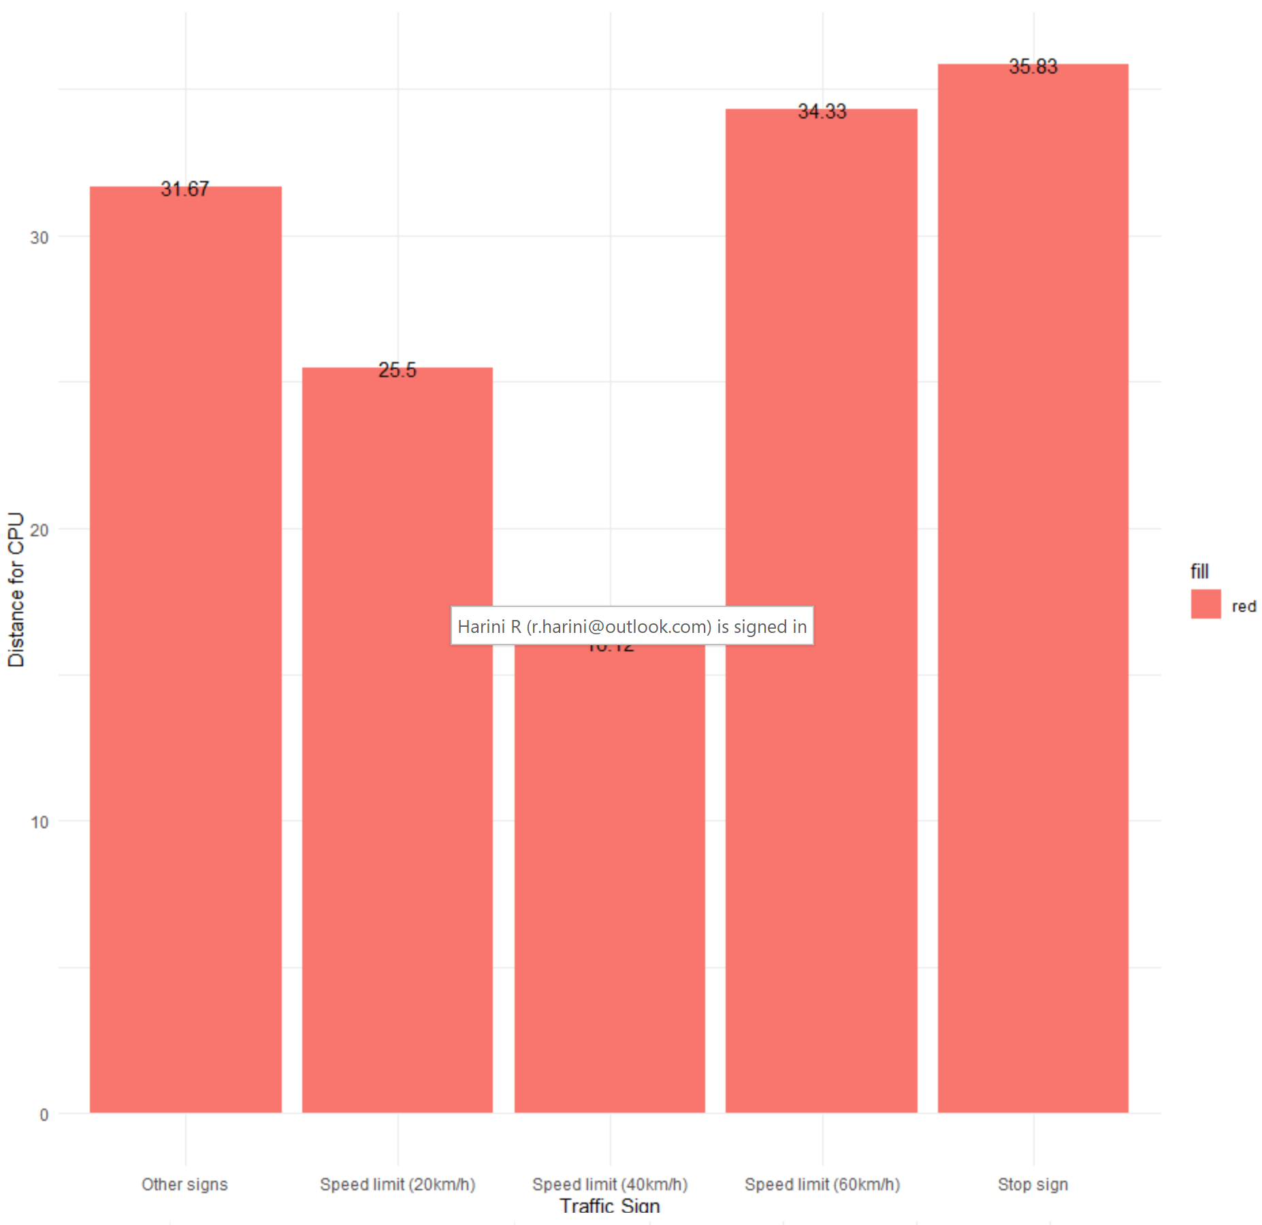
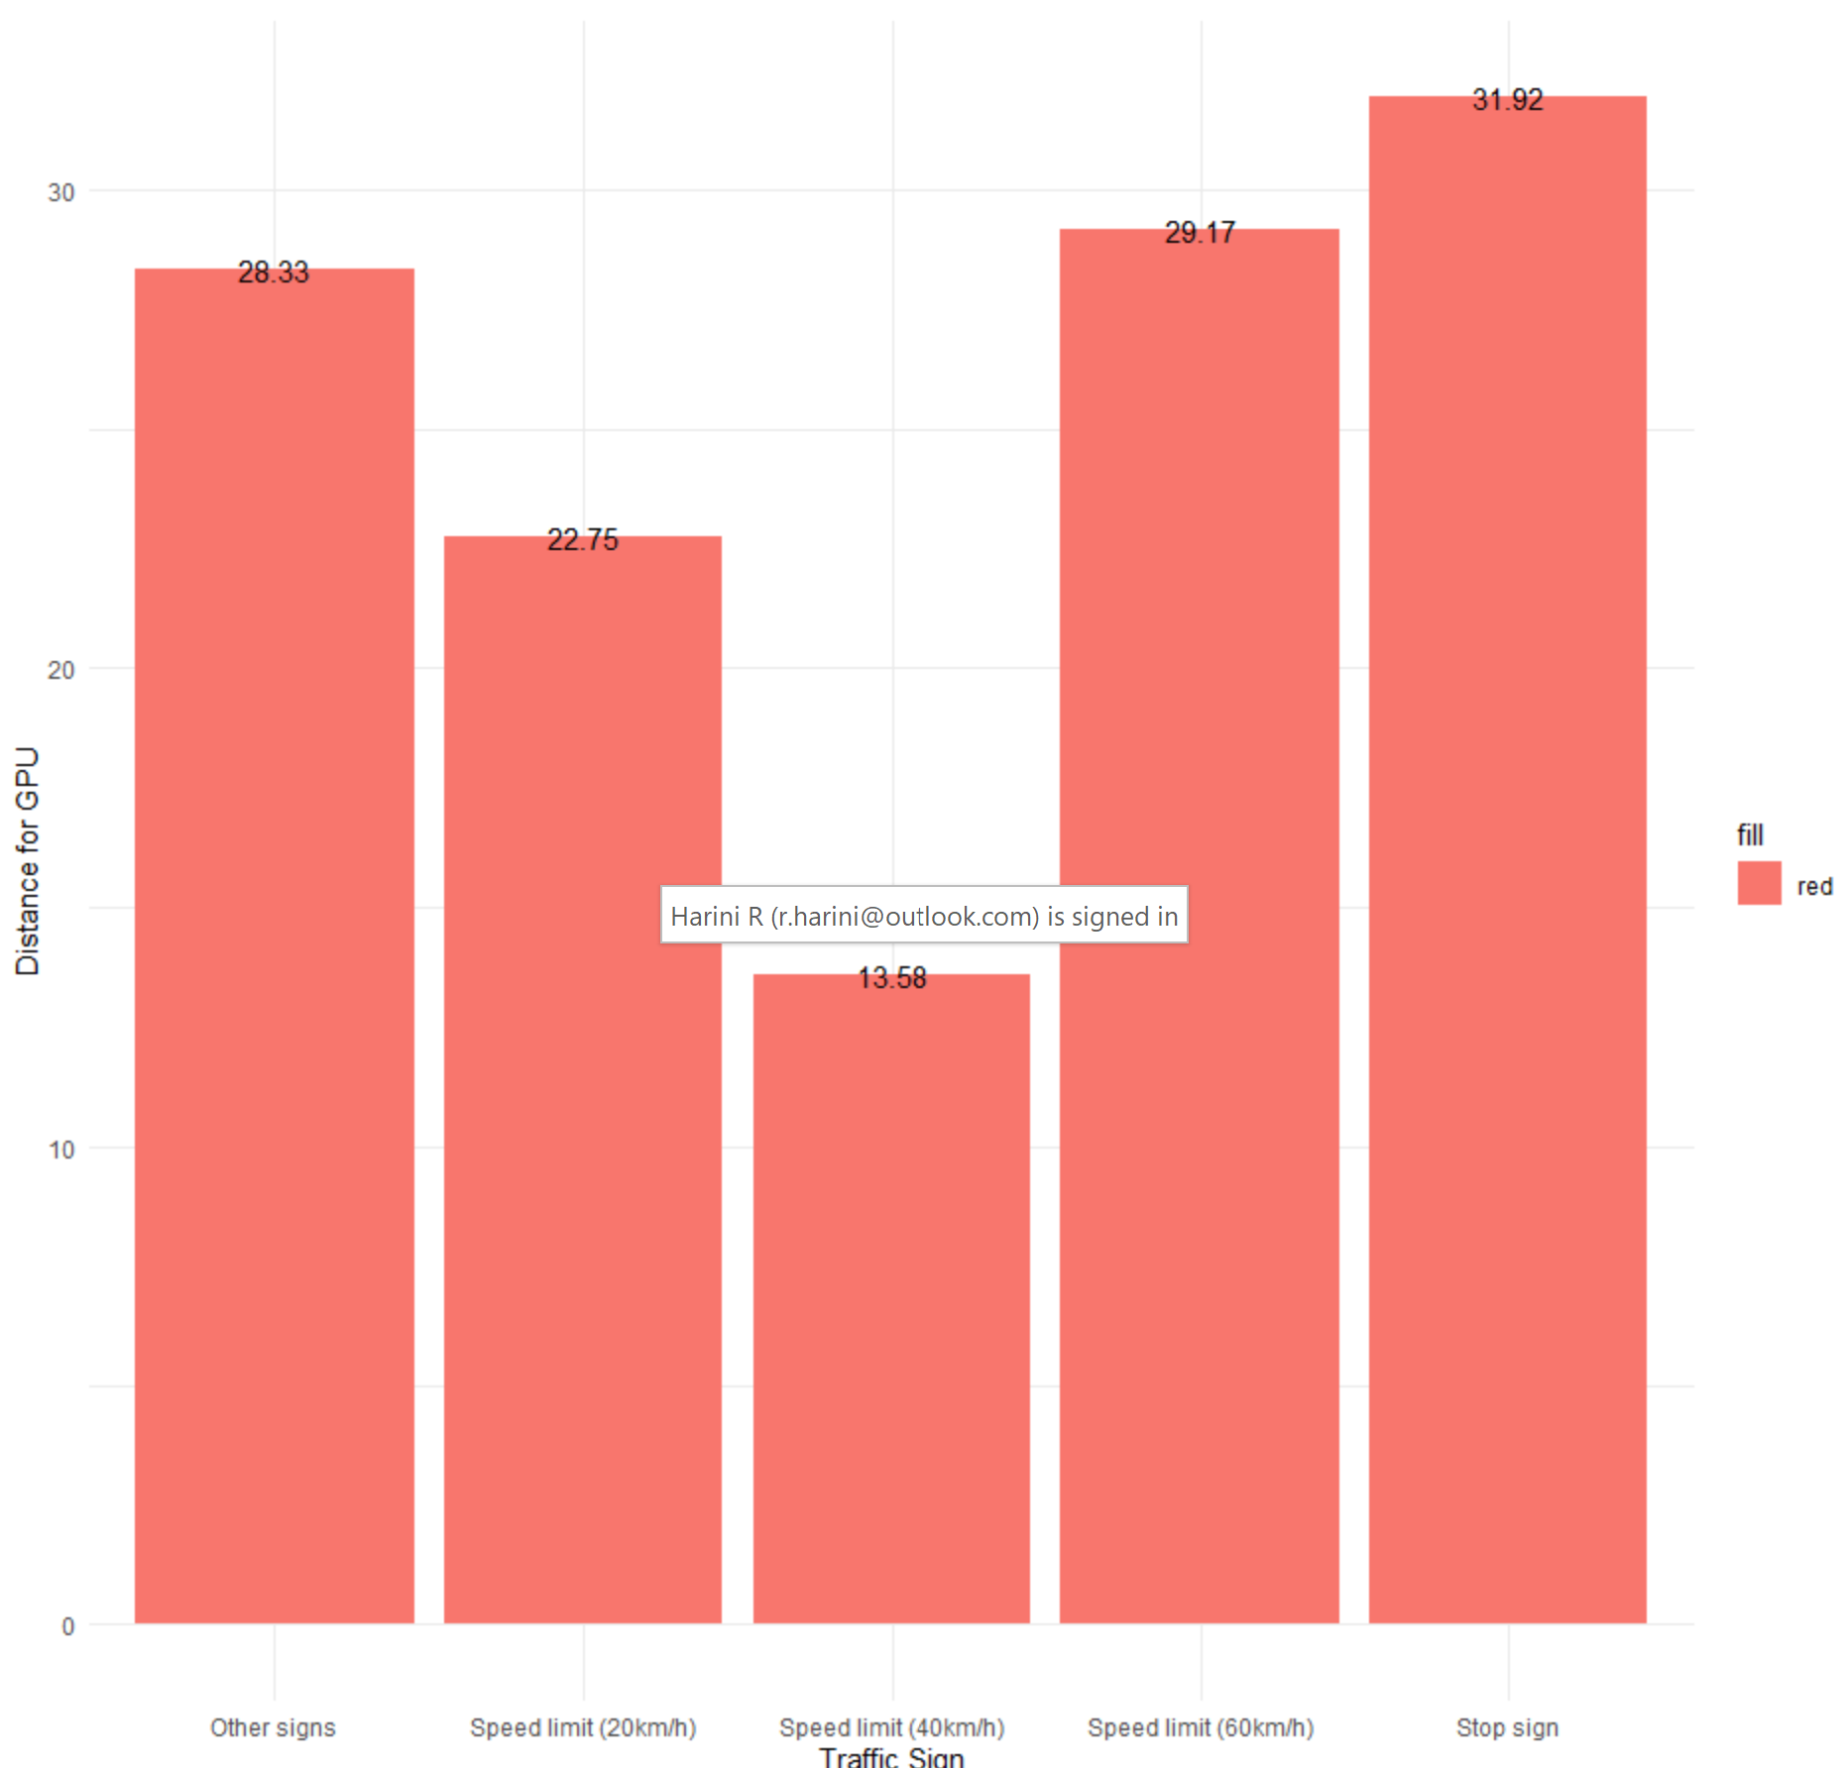
RECOGNISING DISTANCE FOR BASIC SIGNS (for ML models)
Assuming the average speed of vehicle to be 50km/h

Slide 10
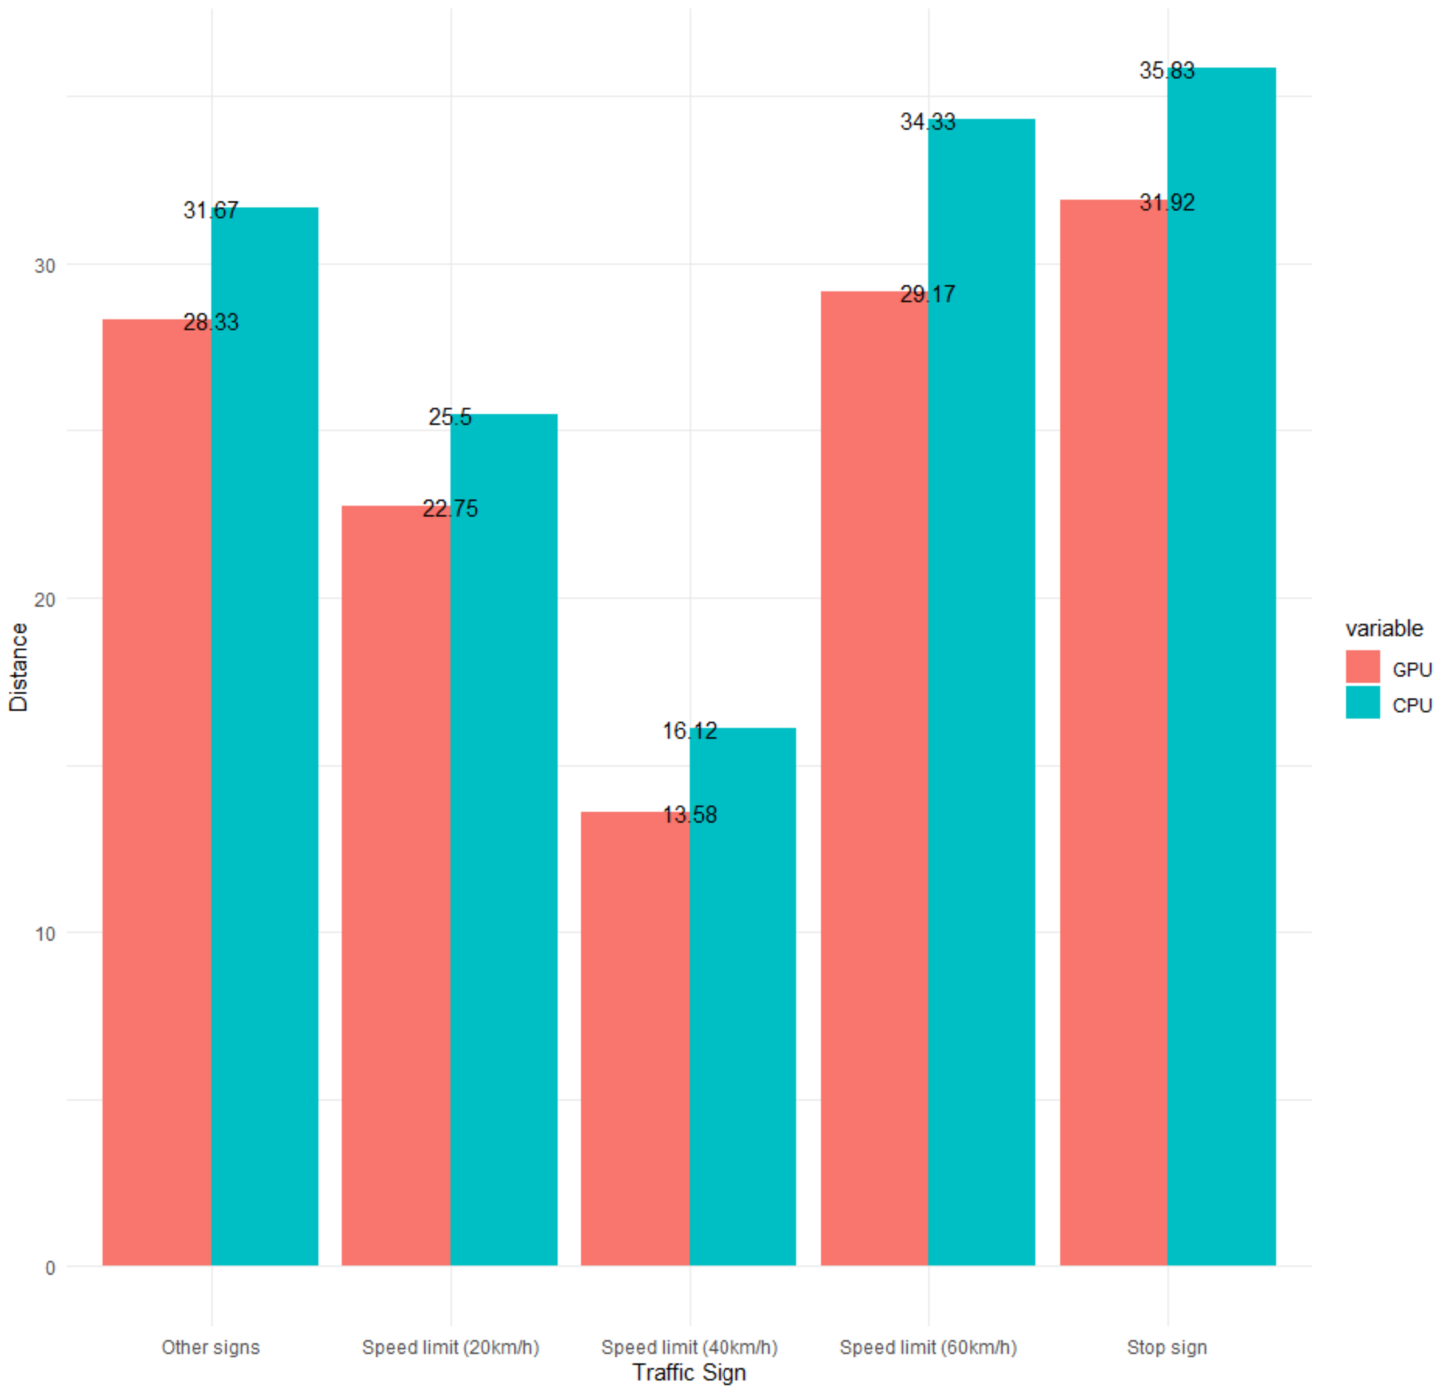

Slide 11
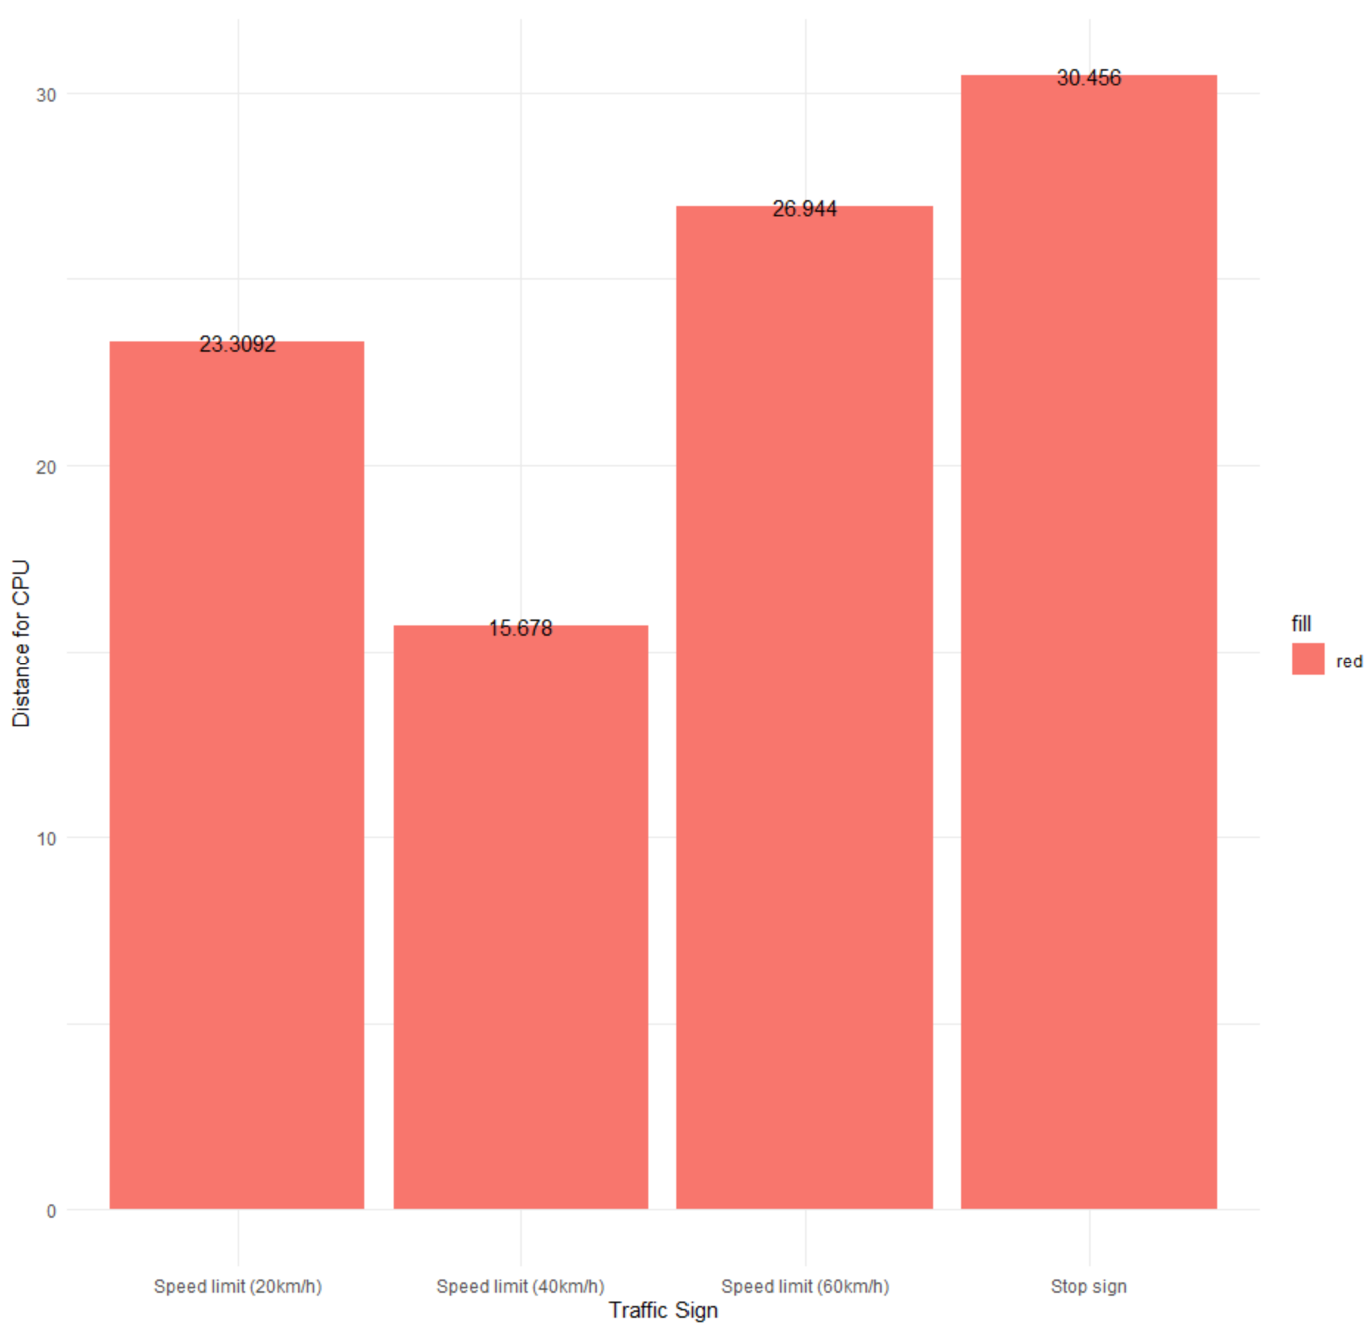
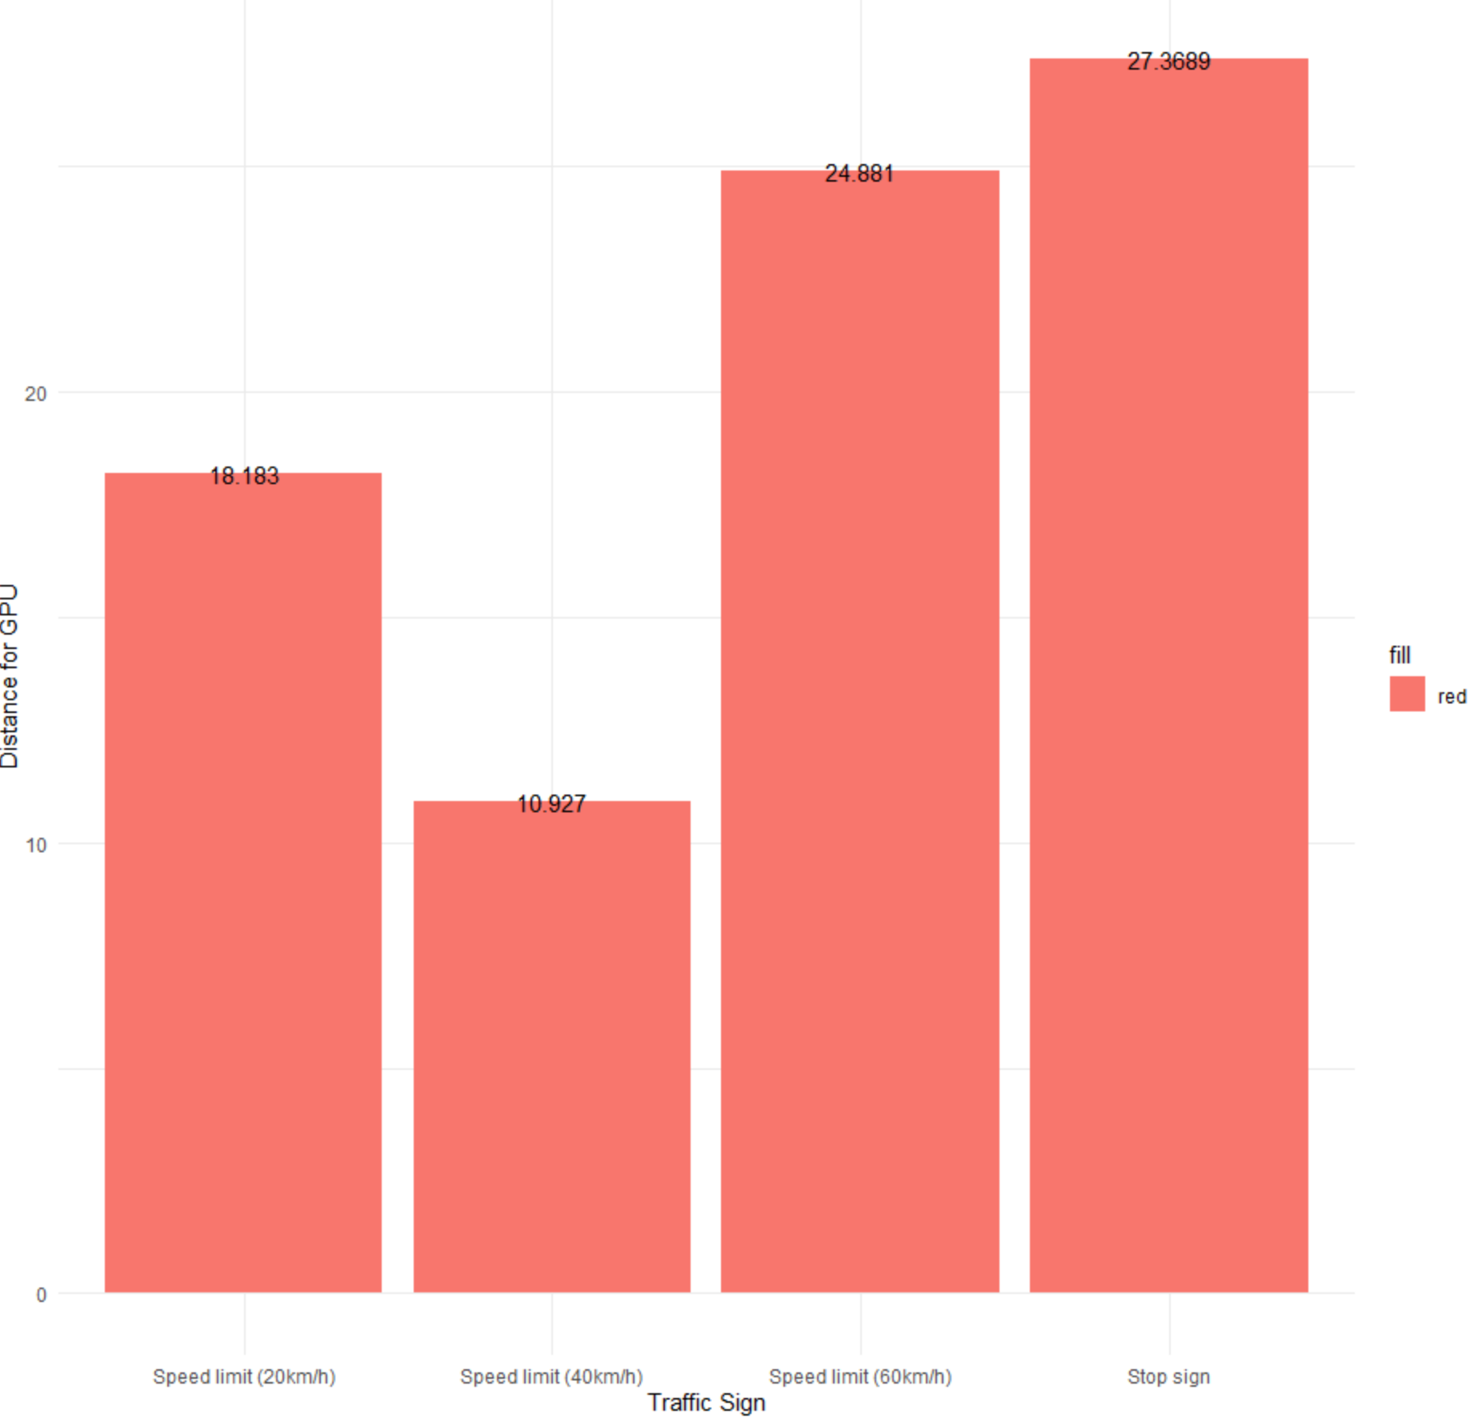
RECOGNISING DISTANCE FOR BASIC SIGNS (for ConvNet)
Assuming the average speed of a vehicle to be 50km/h.
Distance for CPU
Distance for GPU

Slide 12
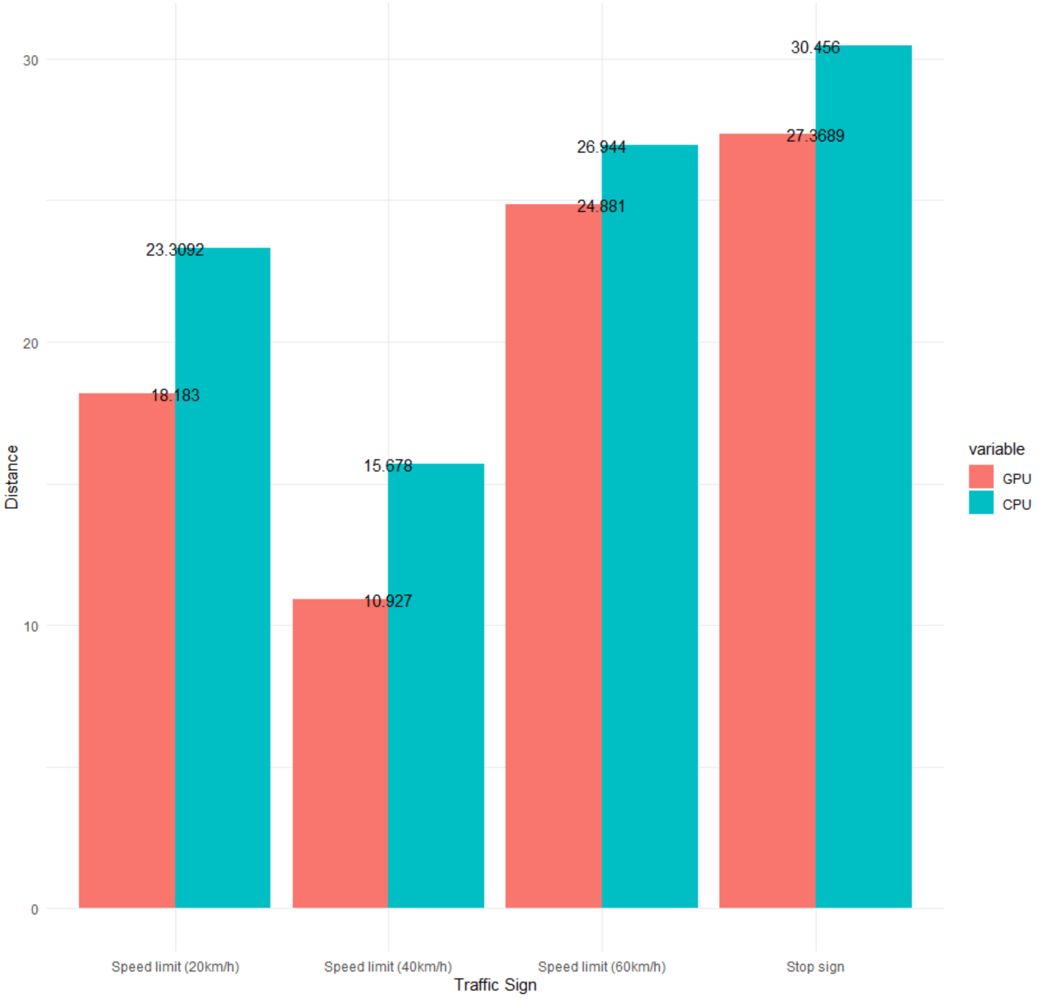

Slide 13
REFERENCES
CNN Design for Real-Time Traffic Sign Recognition https://www.sciencedirect.com/science/article/pii/S1877705817341231
Automatic Traffic Sign Detection System on SVM https://www.hindawi.com/journals/mpe/2015/250461/
Real-Time Traffic Sign Detection Based on Simple CNNs https://www.ncbi.nlm.nih.gov/pmc/articles/PMC6210476

